Slide 1

Jetpack Compose
2023-24

Slide 2
Implementing a GUI
Traditionally, the creation of GUIs in Android relied on a set of classes inheriting from android.view.View
The approach was highly consistent with many other frameworks and leveraged on object oriented patterns, like composite, observer, strategy, …
Creating a GUI required instantiating a bunch of these classes and configuring the corresponding object in order to provide the expected visual aspect and behaviour
In order to simplify the creation of the visual tree, a sophisticated visual editor has been provided by Android Studio, in order to support visual design
The editor produces an XML-based description of the GUI layout, which is then transformed into a visual tree by an Inflater (typically, when an activity is created)

Slide 3
The limitations of the standard approach
The code of the tree view is split among several files
A layout resource file where the visual hierarchy is defined
An activity/fragment that hosts it and decorates it with event handlers and state management operations
Other resource files (colors.xml, strings.xml, themes.xml) that further specify its visual appearance
State ownership and event handling are intermixed
Each view can choose how to implement these two responsibilities
Data flow is not specified
How information is propagated from one view where an event is detected to sibling and parent view is a matter of choice of the programmer

Slide 4
The Jetpack Compose library
A modern toolkit aimed at simplifying UI development
Inspired by React, Flutter, and Swift
Based on a declarative programming model
Based on a set of @Composable functions
Functions that can call other plain- and / or @Composable-functions, in order to create the visual tree
The library tracks the arguments passed to a composable, and whenever they change, re-invokes it, updating the UI accordingly
Fully declarative and data driven
The programmer is no more responsible of mutating the user interface to track changes in application state
Current state is mapped into component descriptions and the framework takes care of altering the tree-view whenever necessary

Slide 5
Basic principles
Compose is based on a set of composable functions
They represent the building block used to create user interfaces
Each function describes, with a declarative syntax, the aspect and behaviour of the GUI to be built, rather than imperatively drive the construction process
A composable function is a Kotlin function labelled with the @Composable annotation
They use the same syntax as standard functions and can receive parameters of all kinds
They usually do not return a value, but they emit user interface blocks to be rendered by the Compose runtime, by invoking other composable functions in their body
The library provides a set of built-in functions that emit basic widgets and layouts, which group composables

Slide 6
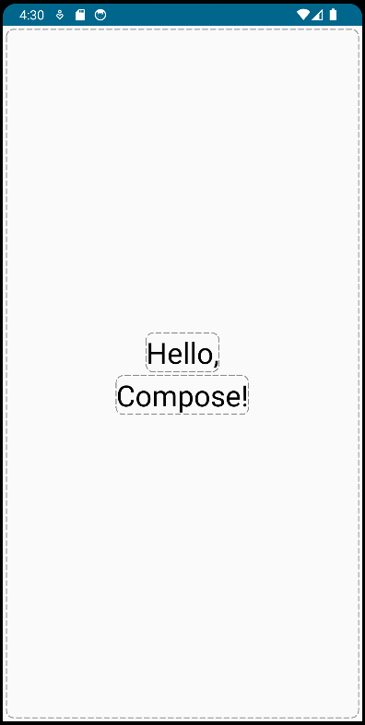
First example
@Composable
fun Greeting() {
Column(
modifier = Modifier.fillMaxSize(),
horizontalAlignment = Alignment.CenterHorizontally,
verticalArrangement = Arrangement.Center,
) {
Text(
"Hello,",
style = MaterialTheme.typography.headlineLarge
)
Text(
"Compose!",
style = MaterialTheme.typography.headlineLarge
)
}
}

Slide 7
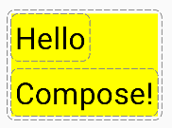
Compose DSL
When a composable offers, amongst its parameters, a trailing lambda, this will typically trigger a hierarchical composition
Composable contained in the trailing lambda will become children of the enclosing composable
Depending on the enclosing element, some extra functionalities can be available inside the lambda (it may be invoked with a receiver)
Trailing lambda
Column(Modifier.background(Color.Yellow)) {
Text("Hello", fontSize = 32.sp)
Text("Compose!", fontSize = 32.sp)
}

Slide 8

Text
Text(…) displays one or more lines of text
It accepts quite a number of parameters, even if only the first one, representing the text to be displayed, is mandatory
Among the parameters, modifier is common to most components
It represents an ordered collection of elements that decorate or add behavior to widgets
Its value is obtained invoking - with a fluent interface - extension functions on the empty Modifier object
Text(
text = "Hello",
fontSize = 64.sp,
modifier = Modifier.size(160.dp)
.background(Color.Yellow)
.wrapContentSize(Alignment.Center)
.blur(8.dp) )

Slide 9
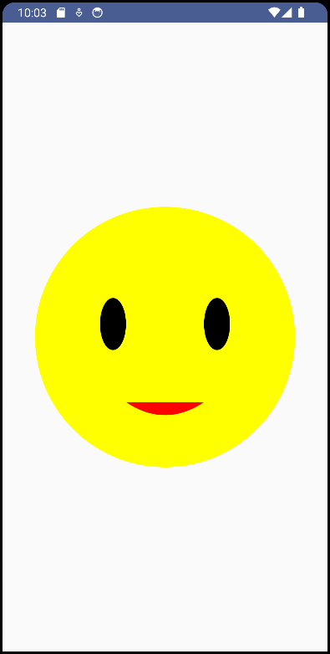
Canvas
Canvas(…) provides a surface upon which custom graphics can be drawn
Its onDraw parameter references a lambda function with DrawScope receiver, that provides a several methods to draw on it
By default, a Canvas has no size, so it must be set via a modifier
Canvas(modifier = Modifier.fillMaxSize(), onDraw = {
val (w,h) = size
val r = 0.4f * min(w,h)
val offsetL = Offset(-r*0.5f, -r*0.3f)
val offsetR = Offset( r*0.3f, -r*0.3f)
val path = Path()
path.moveTo(w*0.5f-r*0.3f, h*0.5f+r*0.5f)
path.relativeQuadraticBezierTo(r*0.3f,r*0.2f, r*0.6f, 0f)
drawCircle(color = Color.Yellow, radius = r, center = center)
drawOval(Color.Black, size = Size(r*0.2f,r*0.4f), topLeft = center+offsetL )
drawOval(Color.Black, size = Size(r*0.2f,r*0.4f), topLeft = center+offsetR )
drawPath(path, Color.Red)
})

Slide 10
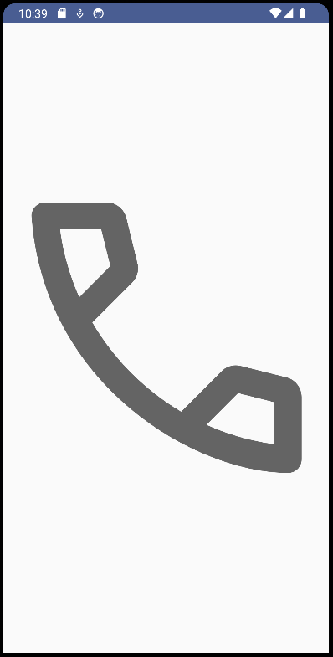
Image
Image(…) is used to display images provided via a Painter instance
By default, it will be sized according to the Painter intrinsic size
A modifier can be provided to adjust sizing or draw additional content (ex. background)
Parameter contentDescription is mandatory: it is used by assistive technologies to present the content of the image
Image(
painter = painterResource(id = androidx.core.R.drawable.ic_call_answer),
contentDescription = "Phone call",
modifier = Modifier.fillMaxSize()
)

Slide 11

Card
Card(…) is used to present a a content that is somewhat lifted, has a custom shape and can trigger an action when clicked
Card(elevation = CardDefaults.cardElevation(8.dp),
modifier = Modifier.padding(16.dp)
) {
Text(text = "Simple Card with 8.dp elevation",
modifier = Modifier.padding(16.dp))
}

Slide 12
Basic layouts
Column(…) is an example of built-in layout composable
It lays out its children vertically, one below the other
Its parameters (horizontalAlignment, verticalArrangement) control children horizontal and vertical positioning when they are smaller than the available space
Row(…) is a similar component that lays out its children horizontally
It has complementary parameters (verticalAlignment, horizontalArrangement)
Box(…) stacks its children along the z-axis, as if they were a deck of cards
The last child is on top of all the preceding ones
A Box will size itself to fit the content, subject to the incoming constraints
When children are smaller than the parent, by default they will be positioned inside the Box according to parameter contentAlignment

Slide 13
Basic layouts
Row() and Column() mimic the behaviour of flex-containers in HTML
Modifier.weight(...) may be applied to their children in order to partition the available space in a different way
Basic layouts can be nested to produce more articulated layouts
They tend to be as pervasive as <div> elements in web pages
Modifier.padding(...) may be applied to them in order to leave some empty space between the children and the parent

Slide 14
Creating complex layouts
Differently from traditionals views, Compose handles nested layouts efficiently, making them a great way to design complex UI
It is pretty common to create visualizations based on Boxes encapsulating Columns encapsulating Rows
In order to guarantee the customizability of the outcome, intermediate composables are often defined having a modifier parameter
Which has, as a default value, the empty Modifier constructor
@Composable
fun ProductCard(modifier: Modifier = Modifier) {
Column(modifier = modifier, … ) { … }
}

Slide 15
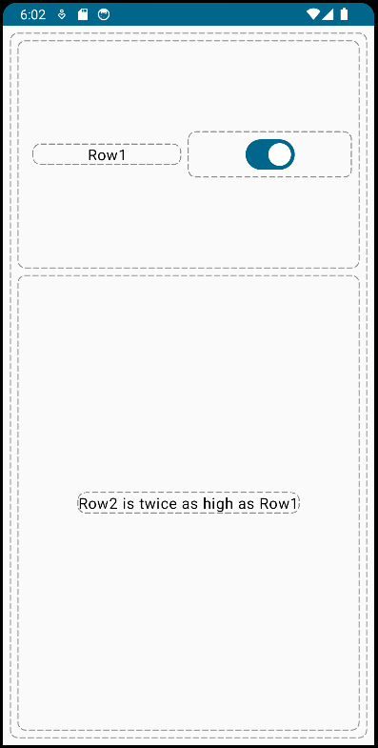
Basic layouts
@Composable
fun SimpleLayout() {
Column(Modifier.fillMaxSize()) {
Row(
Modifier.fillMaxWidth()
.weight(1f),
verticalAlignment =Alignment.CenterVertically ) {
Text("Row1",
Modifier.weight(1f),
textAlign = TextAlign.Center)
Switch(checked = true, onCheckedChange = {},
modifier = Modifier.weight(1f) )
}
Box(Modifier.fillMaxWidth().weight(2f),
contentAlignment = Alignment.Center ) {
Text("Row2 is twice as high as Row1")
}
}
}

Slide 16
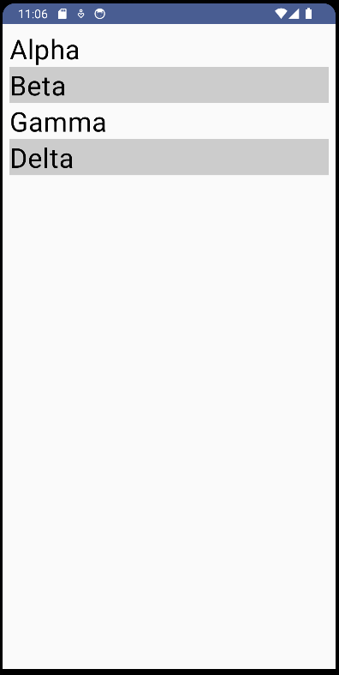
Composable functions
Since composable functions are, primarily, functions, they are not limited to just emitting other composable
They can have parameters, use branches and loops to control their composition
Whenever they invoke another composable function, the corresponding component is emitted
@Composable
fun SimpleList(l: List<String>, modifier: Modifier) {
Column(modifier = modifier) {
l.withIndex().forEach() {
val mod = if (it.index %2 == 0) Modifier
else Modifier.background(Color.LightGray).fillMaxWidth()
Text(text = it.value, modifier = mod, fontSize=32.sp)
}
}
}

Slide 17
Lists and grids
Even if it is simple to emit composables out of a list of data items, this is not necessarily a good thing to do
If the list contains many items, a lot of composables will be emitted, but - possibly - most of them will not be visible, since their position will be outside of the screen bounds
Moreover, layout are not scrollable by default
Compose provides a bunch of Lazy* components aimed at displaying in a resource-effective way collections of items
LazyColumn(…) is vertically scrolling list that only composes and lays out the currently visible items
LazyRow(…) lays out visible items in an horizontally scrolling row
LazyHorizontalGrid(…) and LazyVerticalGrid(…) create scrollable grids

Slide 18
Lists and grids
Lazy* components provide a LazyListScope.() block that offers a DSL to describe the contents
items(...) accepts a list or an array of items and a lambda responsible of emitting the content for each visible element in the container
item(...) provides a similar behaviour for a single element
indexedItems(...) provide the lambda function with an extra parameter reporting the current index
stickyHeader(...) emits an header item, which will remain pinned even when scrolling after it

Slide 19
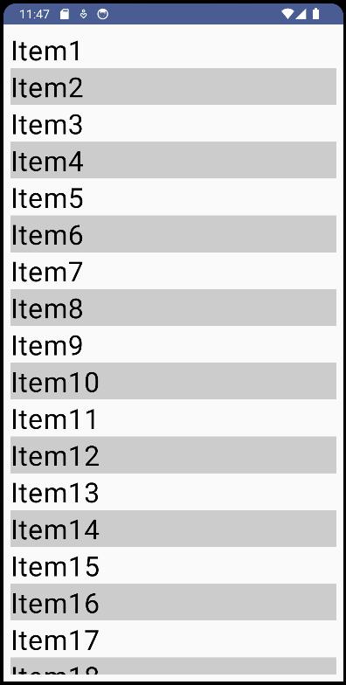
Lists and grids
@Composable
fun ScrollingList(l: List<String>, modifier: Modifier) {
LazyColumn(modifier = modifier) {
itemsIndexed(l) { index,text ->
val mod = if (index %2 == 0) Modifier
else Modifier.background(Color.LightGray).fillMaxWidth()
Text(text, fontSize = 32.sp, modifier = mod)
}
}
}

Slide 20
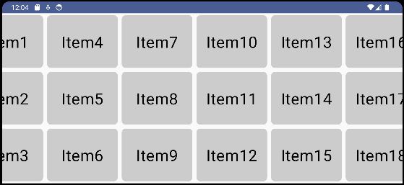
Lists and grids
@Composable
fun ScrollingGrid(data: List<String>, modifier: Modifier) {
LazyHorizontalGrid(rows = GridCells.Fixed(3), modifier = modifier) {
items(data) {
Box(modifier = Modifier.padding(4.dp)) {
Text(it,
Modifier.fillMaxHeight()
.aspectRatio(4f / 3f)
.background(
Color.LightGray,
RoundedCornerShape(8.dp))
.wrapContentSize(),
fontSize = 32.sp)
}
}
}
}

Slide 21
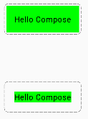
Modifiers
Most composable functions accept, amongst their parameters, a Modifier
It provides decorations and behaviour to the element, offering a fluent API which makes it easy to specify several cascading details
The order of modifiers matters!
Text(text = "Hello Compose",
modifier = Modifier.background(Color.Green)
.padding(16.dp)
)
Text(text = "Hello Compose",
modifier = Modifier.padding(16.dp)
.background(Color.Green)
)

Slide 22

Modifiers
When adding a modifier as an argument to a composable the parameter must be labeled "modifier" and placed at the top of the list of optional parameters for the function
The modifier parameter has to be optional in order for the function to be called without it: this means that the parameter default value must be an empty Modifier instance
@Composable
fun CustomImage(imageId: Int, modifier: Modifier = Modifier) {
Image(painter = painterResource(id = imageId),
contentDescription = "",
modifier)
}
CustomImage(R.drawable.vacation, Modifier
.padding(16.dp)
.width(270.dp)
.clip(shape = RoundedCornerShape(30.dp)))

Slide 23
Built-in modifiers
background(…)
Draws a solid colored shape behind the composable.
clickable(…)
Defines a handler that will be invoked when the composable is clicked. When the click is performed, it also causes a ripple effect
clip(…)
Clips the composable content to a specified shape
fillMaxHeight(…)
The composable will be sized to fit the parent's maximum height.
fillMaxSize(…)
The composable will be sized to fit the parent's maximum height and width.
fillMaxWidth(…)
The composable will be sized to fit the parent's maximum width
offset(…)
Moves the composable the specified distance along the x and y axes from its current position
padding(…)
Increases the amount of space around an object.

Slide 24
Built-in modifiers
To apply several Modifier to the same composable, Compose allows modifiers to be combined by using the then(…) method
val modifier = Modifier
.border(width = 2.dp, color = Color.Black)
.padding(all = 10.dp)
val secondModifier = Modifier.height(100.dp)
Text(
"Hello Compose",
modifier.then(secondModifier),
fontSize = 40.sp,
fontWeight = FontWeight.Bold
)

Slide 25
Custom modifiers
It is relatively easy to create custom modifiers, as extension functions of the Modifier interface
The framework offers many modifiers that can be combined together in order to provide a custom behavior
A custom modifier can leverage on the predefined drawWithContent(…) function that allows the developer to draw before or after the layout contents as well as to adjust the layout canvas

Slide 26

Custom modifier
fun Modifier.dashedBorder() = this.drawWithContent {
val outline = RoundedCornerShape(8.dp).createOutline(size, layoutDirection, this)
val path = Path().apply { addOutline(outline) }
val stroke = Stroke(
cap = StrokeCap.Round,
width = 1.dp.toPx(),
pathEffect = PathEffect.dashPathEffect(intervals = floatArrayOf(16.0f, 8.0f))
)
this.drawContent()
drawPath(path = path, style = stroke, color = Color.Gray)
}.padding(4.dp)
Text(text = "Custom Modifier",
modifier = Modifier.dashedBorder().background(Color.Yellow),
fontSize = 32.sp )

Slide 27
State in composables
Composable can be stateless or stateful
Stateless composables emissions are driven only by the parameters they receive: if the function is invoked with the same set of parameters it will produce the same result
Stateful composables encapsulate mutable values which affect both themselves and the composables they invoke: when the values change, a process named recomposition is triggered, possibly re-emitting different interface blocks
Local variables cannot be used to store state
Since their content is lost whenever the function execution terminates
Global variable too are inadequate
Since a single component can be emitted many times and each emission would require its own state

Slide 28
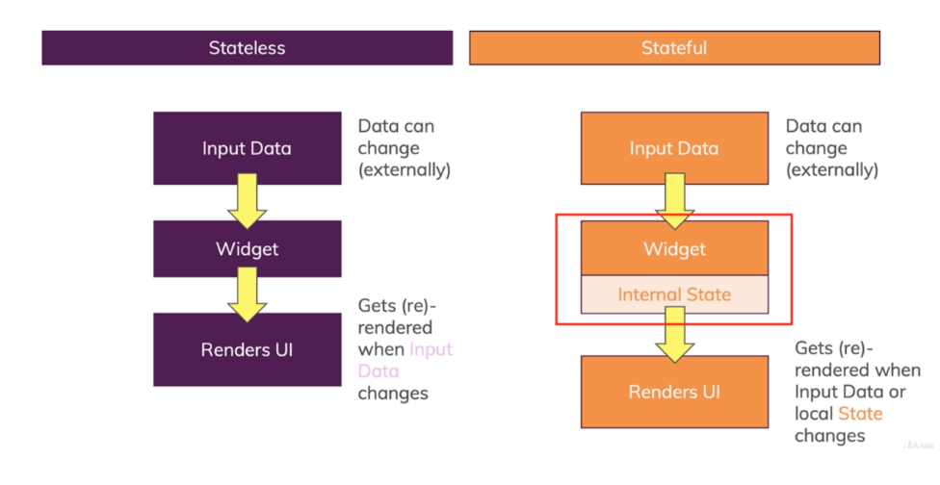
Stateless vs stateful

Slide 29
State, composition, and recomposition
In order to create the UI, the Compose framework invokes a composable function and records the set of built-in composables that it emits, together with their nesting
A tree view is then built according to the outcoming hierarchy
This phase is called initial composition
When an argument of a composable function or the state it based upon changes, the composable function is executed again
The effects of its re-invocation replace the portion of view tree that it previously generated
This phase is called recomposition

Slide 30
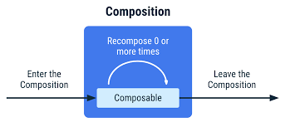
State, composition, and recomposition
Recomposition skips as many composable functions and lambdas as possible, based on parameters that did not change
Moreover, it is optimistic, expecting input parameters not to change before the recomposition phase ends
In case a change occurs while a recomposition is ongoing, the recomposition is cancelled, the provisional view tree is discarded, and the whole process is started again

Slide 31
Composable are pure functions
Although composables look like “standard” Kotlin functions, in fact they are not
Composable functions are transformed by the compiler into an expanded version, providing an explicit composition context
Composable functions can execute in any order
Compose may take advantage of available cores by running in parallel sibling composables
If a composable function directly invoked any method which has side-effects, those effects could be executed several times, since the framework might call that function from several different threads at the same time
For this reason, any side-effect should be managed via the LaunchedEffect abstraction
Alternatively, side-effects can be produced by call-back functions, like onClick(…), that always execute in the UI thread

Slide 32
Remembering the state
If a composable function is stateful, it must leverage on the framework to keep its state and track its evolution
Whenever a piece of state changes, the component relying on it must be recomposed
To this purpose, Compose offers the remember(…) function as well as the State<T> generic interface (and its derivative, MutableState<T>)
State<T> incapsulate a piece of data
remember(…) wraps it into a monad tied to the current composable, so that any change to it can be tracked and trigger the recomposition process
When the composable that has invoked remember is removed by the composition, the value is forgotten
This behaviour matches closely the one of the useState<T>(…) hook in the React framework

Slide 33
State handling in composables
There are three equivalent ways to declare a MutableState in a composable
val mutableState = remember { mutableStateOf( initialValue ) }
var value by remember { mutableStateOf( initialValue ) }
val (value, setValue) = remember { mutableStateOf( initialValue ) }
The remembered value can be used as a parameter for other composables
Or can be used to trigger conditional composition, by changing it
Changes to MutableState should only occur in the main thread
Typically inside callbacks
Setter methods cannot be invoked during the composition or recomposition phases

Slide 34
Managing the state
@Composable
fun ExpandableBlock(title: String, body:String) {
val (expanded, setExpanded) = remember {
mutableStateOf(false)
}
val b = if(expanded) "\u25b2" else "\u25bc"
Column(Modifier.padding(8.dp)) {
Row {
Text(text = title,
style = MaterialTheme.typography.headlineLarge,
modifier = Modifier.weight(1f) )
OutlinedButton(
onClick = { setExpanded(!expanded) }
) { Text(b) }
}
if (expanded) { Text(body, Modifier.padding(top = 8.dp)) }
}
}

Slide 35
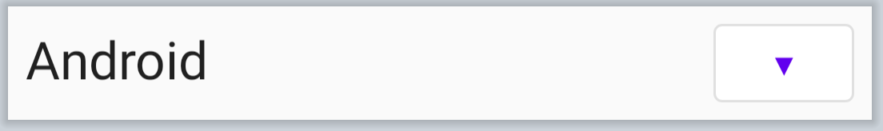

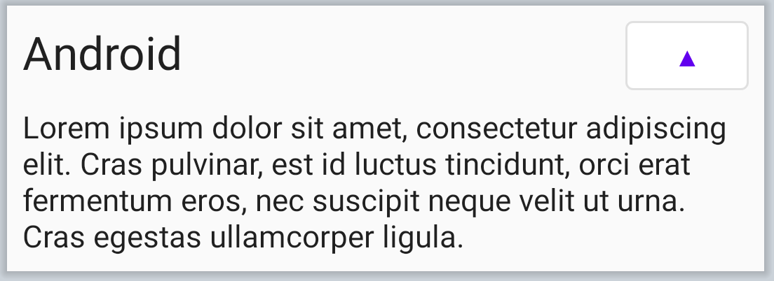
Managing the state

Slide 36
Managing the state
@Composable
fun ExpandableBlock(title: String, body:String) {
val (expanded, setExpand) = remember {
mutableStateOf(false)
}
val b = if(expanded) "\u25b2" else "\u25bc"
Column(Modifier.padding(8.dp)) {
Row {
Text(text = title,
style = MaterialTheme.typography.headlineLarge,
modifier = Modifier.weight(1f) )
OutlinedButton(
onClick = { setExpand(!expanded) }
) { Text(b) }
}
if (expanded) { Text(body, Modifier.padding(top = 8.dp)) }
}
}
Local state handling logic
Since composable functions must be idempotent and free of side-effects, local state is managed via the remember composable: it stores a value in memory during the initial composition and returns it during recomposition

Slide 37
Managing the state
@Composable
fun ExpandableBlock(title: String, body:String) {
val (expanded, setExpand) = remember {
mutableStateOf(false)
}
val b = if(expanded) "\u25b2" else "\u25bc"
Column(Modifier.padding(8.dp)) {
Row {
Text(text = title,
style = MaterialTheme.typography.headlineLarge,
modifier = Modifier.weight(1f) )
OutlinedButton(
onClick = { setExpand(!expanded) }
) { Text(b) }
}
if (expanded) { Text(body, Modifier.padding(top = 8.dp)) }
}
}
Conditional composition
Based on the current state, different components may be emitted

Slide 38

Input widgets
Most input widgets are stateful
They require as parameters the present value and a callback to notify of any change
These values are easily derived from a remembered MutableState (if the state is local to composable) or received as an argument from the invoking composable
@Composable
fun InputPane(onOk: (v:String)->Unit) {
val (data, setData) = remember { mutableStateOf("") }
Row(Modifier.fillMaxWidth().padding(8.dp)) {
TextField(value = data, onValueChange = setData,
modifier = Modifier.weight(1f))
Spacer(modifier = Modifier.width(8.dp))
Button(onClick = { onOk(data) }) { Text("Ok") }
}
}

Slide 39

Button widgets
Buttons are amongst the simplest input component: they allow the user to trigger an action
Button(...) classic button with solid background: used for primary actions
FilledTonalButton(...) lighter background: used for significant actions
ElevatedButton(...) cast a shadow to appear prominent: also for significant actions
OutlinedButton(...) has a border but no fill: used for less important actions
TextButton(...) no background or border: used for secondary actions
All variations requires the onClick parameter that specifies the action to execute

Slide 40


Input widgets
Switch(...) allows users to toggle between two states
It requires two mandatory parameters: checked, the specifies its current state, and onCheckedChange, a callback that is invoked upon user interaction
Slider(...) allows users to select a value in a given range
Again, two mandatory parameters are required: value and onValueChange
RangeSlider(...) allows users to select two values in a given range
The two values are dealt with as a ClosedFloatingPointRange<Float> object
val (value, setValue) = remember { mutableStateOf(0.0f..100f) }
RangeSlider(value = value, onValueChange = setValue,
steps = 9, valueRange = 0f..100f,
modifier = Modifier.padding(horizontal = 16.dp)
)

Slide 41
State hoisting
If a component encapsulates some state, it can only affect the component itself or its children
Provided that the state or any derivative of it is forwarded, as a parameter, to them
If an action happening in a component must affect any of its siblings or ancestors, the corresponding state should be hoisted to highest composable encompassing all the elements to be affected
Such a state and its mutator(s) must then be propagated downwards to any descendant needing it
Such a propagation might encompass several intermediate elements, which would receive some parameters only to forward them to their own children

Slide 42
Unidirectional data flow
State
Compose applications favors the unidirectional data flow pattern
State is maintained in the topmost part of the visual tree, and descends towards the leaves
User interactions cause event to be raised in those leaves
Events are propagated upwards, until they reach the place where the state is kept
This causes the state to be updated
Column
State
Events
Image
Row
TextInput
Button

Slide 43
Styling composables
Compose has been designed to provide components that match the styling guidelines described at m3.material.io
This is the most recent version of the style
All elements in this group can be styled via Material Theming, a systematic way to customize colors, typography and shapes to reflect a product’s brand
A special composable, MaterialTheme(…), allows to set these features, according to the designer’s will, providing an easy support for both light and dark variations of the theme

Slide 44

Learning more
Under the hood of Jetpack Compose
https://medium.com/androiddevelopers/understanding-jetpack-compose-part-1-of-2-ca316fe39050
https://medium.com/androiddevelopers/under-the-hood-of-jetpack-compose-part-2-of-2-37b2c20c6cdd
Jetpack Compose State Guideline
https://medium.com/@takahirom/jetpack-compose-state-guideline-494d467b6e76
Jetpack Compose: MVVM State management in a simple way
https://blog.canopas.com/jetpack-compose-mvvm-state-management-in-a-simple-way-4c632fa6f554
React to Jetpack Compose RC Dictionary
https://tigeroakes.com/posts/react-to-compose-dictionary/

